Slide 1

MORE ABOUT YOUR
RESEARCH PROPOSAL
Notes:
C:\Figures\Chapter03\high-res\Alcock8e-ChOpener-03.jpg

Slide 2
THE ASSIGNMENT:
Read and understand several journal articles about animal behaviour.
Think about how you could adapt what you learned in those articles …
to an original study designed by you!!!
Example: you’ve read about black bears and propose to study grizzly bears.

Slide 3
Your “proposal” will look much like a scientific journal article (using similar sections and with solid support from the literature).
Except that much of it will be written in future tense because it hasn’t happened yet!
Reference other people’s ideas … and use the active voice when referring to your own ideas: “I will broadcast the sounds of various hawks to the loons”.

Slide 4
Make use of the ideas that we will discuss about designing behavioural studies:
Ask a clear research question, have an array of reasonable hypotheses, think of objective ways of testing your hypotheses, etc.
Design a clever study that can’t be picked apart by skeptics.
Convince me that this is an important and feasible study that should be funded $$$$$!!!!!

Slide 5
YOUR PROPOSAL SHOULD HAVE THE FOLLOWING SECTIONS …
INTRODUCTION
This is where you provide background info and mention key references.
Provide rationale of why this study should be done.
Outline your hypotheses.
State your aims.
(Be sure to mention scientific names asap, and imitate the style of a journal.)

Slide 6
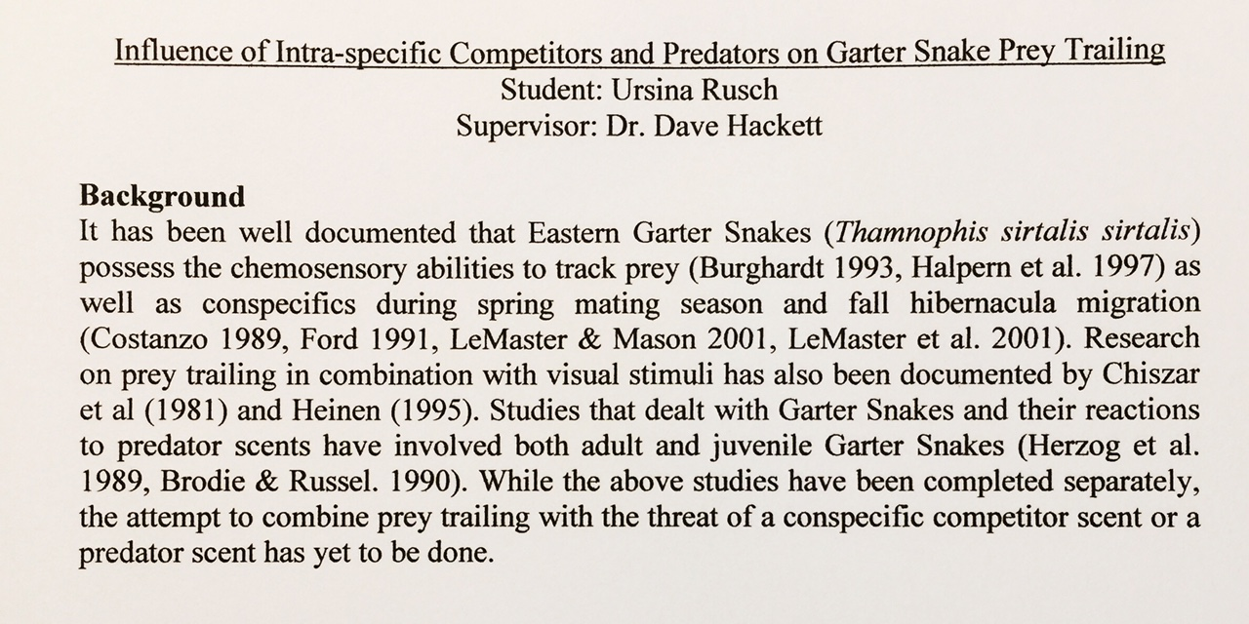

Slide 7
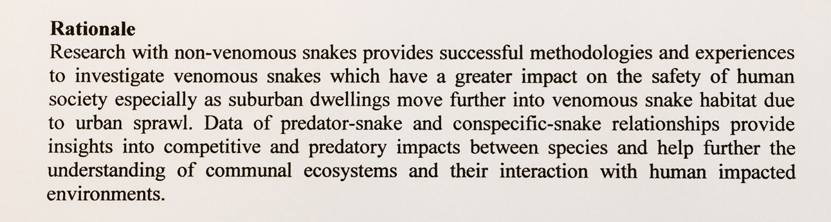

Slide 8
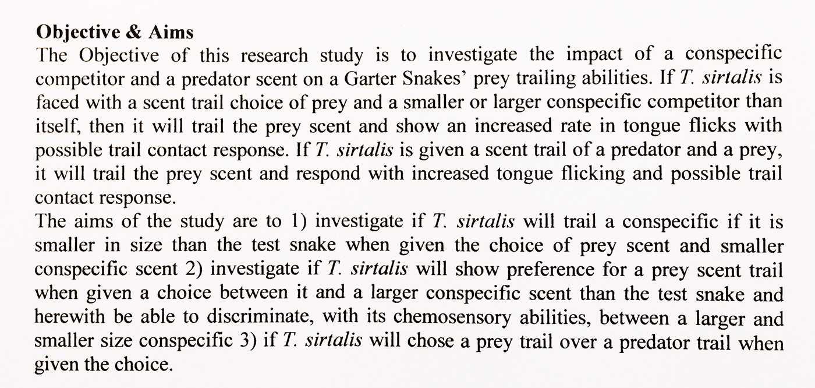

Slide 9
YOUR PROPOSAL SHOULD HAVE THE FOLLOWING SECTIONS …
METHODS
Explain the techniques and analyses that you propose to use.
Give enough detail so that somebody could actually do the study.
If you “borrow” somebody’s ideas or techniques, provide a reference.
This is the section that funders will scrutinize to see if your study would work!

Slide 10
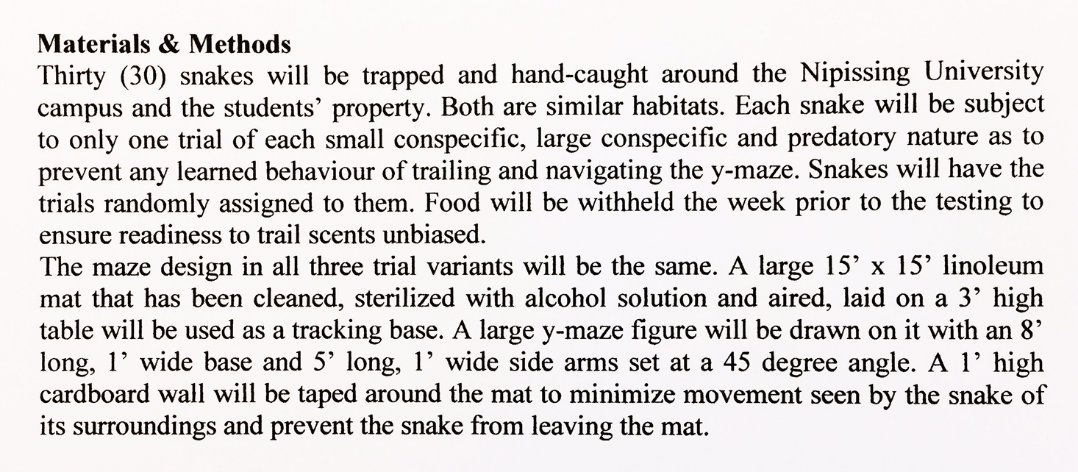

Slide 11
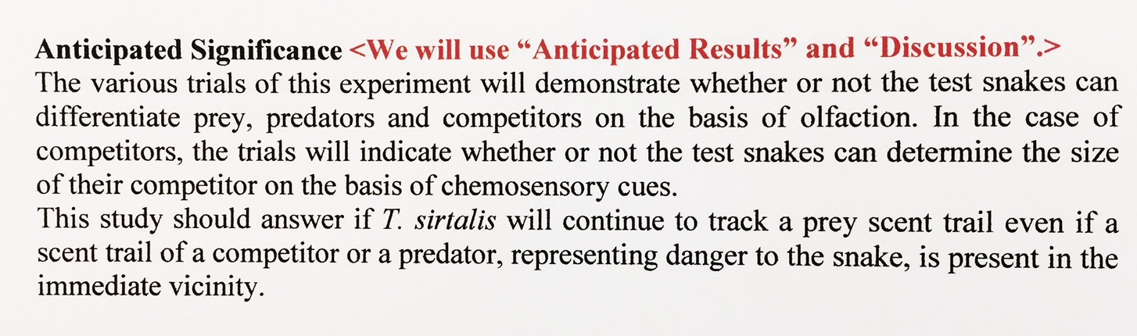

Slide 12
YOUR PROPOSAL SHOULD HAVE THE FOLLOWING SECTIONS …
ANTICIPATED (or Potential) RESULTS
Explain the various outcomes that could occur, and which of your hypotheses would be supported or weakened by each of these outcomes.
You won’t have any actual data, but you hopefully have a clear idea of what you are looking for.
The funders want to know that solid results and clear outcomes will be generated by your study.

Slide 13
YOUR PROPOSAL SHOULD HAVE THE FOLLOWING SECTIONS …
DISCUSSION
Now explain the meaning of the various outcomes that could occur.
Which is most likely and why?
How exactly would you interpret these findings re your various hypotheses?
Would your findings agree with, or contradict, or add to, the literature?
Reach a scientific conclusion.
Make sure that your funders will see the value of your study.

Slide 14
YOUR PROPOSAL SHOULD HAVE THE FOLLOWING SECTIONS …
LITERATURE CITED
Make sure you use this title.
Include all articles you cited … and nothing else.
This section should be impressive … and absolutely correct.
Pay strict attention to details and style.
Funders, markers, and readers will pore over this section!!!

Slide 15
